Slide 1
HTML
Created By Manas K Sahoo/India/IBM

Slide 2
Day 1

Slide 3
Objectives
Getting Started With HTML
  Introducing HTML
  How Web pages work
  Introduction to Tags
  Structure of HTML page
Creating a Web Page
  Introduction table, tr, td tags
  Paragraphs and Line breaks
  Headings
  Creating Ordered and Unordered List
Text Formatting And Alignment
  Boldfaces and Italics
  Font Size, Color and Typeface
  Special Characters

Slide 4
Objectives
Using Links & Images
Using Frames
Style Sheet
  Purpose of Style Sheet
  Style Rules
  Attaching Style Sheet
  Defining classes
  Div tag, Span Tag
  Using Span
Developing Forms
  Introducing Forms
  Using Standard Form Controls

Slide 5
Day – 1 Coverage
Getting Started With HTML
  Introducing HTML
  How Web pages work
  Introduction to Tags
  Structure of HTML page
  Commonly Used Tags
Creating a Web Page
  Introduction table, tr, td tags
  Paragraphs and Line breaks
  Headings
  Creating Ordered and Unordered List
Text Formatting And Alignment
  Boldfaces and Italics
  Font Size, Color and Typeface

Slide 6
Introducing HTML
To publish information for global distribution, one needs a universally understood language, a kind of publishing mother tongue that all computers may potentially understand. The publishing language used by the World Wide Web is HTML (from HyperText Markup Language).
What is HTML
Notes:
History of HTML
Tim Berners-Lee created the original HTML (and associated protocols such as HTTP on a NeXTcube workstation using the NeXTSTEP development environment. At the time, HTML was not a specification, but a collection of loosely defined elements to solve an immediate problem: the communication and dissemination of ongoing research between Berners-Lee and his colleagues. His solution later combined with the emerging international and public internet to garner worldwide attention.
HTML stands for Hypertext Markup Language.
Hypertext
Hypertext most often refers to text on a computer that will lead the user to other, related information on demand. It is an ordinary text that has been dressed up with extra features, such as formatting, images, multimedia, and links to other documents.
Markup is the process of taking ordinary text and adding extra symbols. Each of the symbols used for markup in HTML is a command that tells a browser how to display the text.
Using HTML 4.1 Version

Slide 7
Introducing HTML
HTML contains special markers, or tags, which define the style and structure of the page.
What is HTML
Tags are also referred to as elements.

Slide 8
Introducing HTML
Uses of HTML
Publish online documents with headings, texts, tables, lists, photos, etc.
Retrieve online information via hypertexts links.
Design forms for conducting transactions with remote services, for use in searching for information, making reservations, ordering products, etc.
Include spread-sheets, video clips, sound clips, and other applications directly in their documents.

Slide 9
How To Access An Web Page
Click To Proceed With The Steps

Slide 10
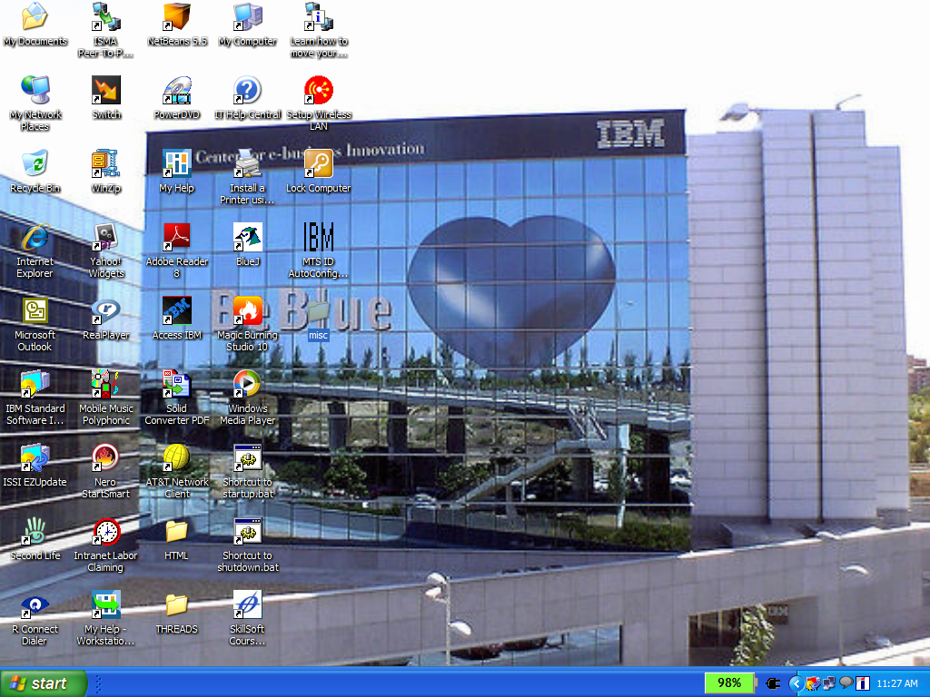
Double Click on the
Internet Explorer
button

Slide 11
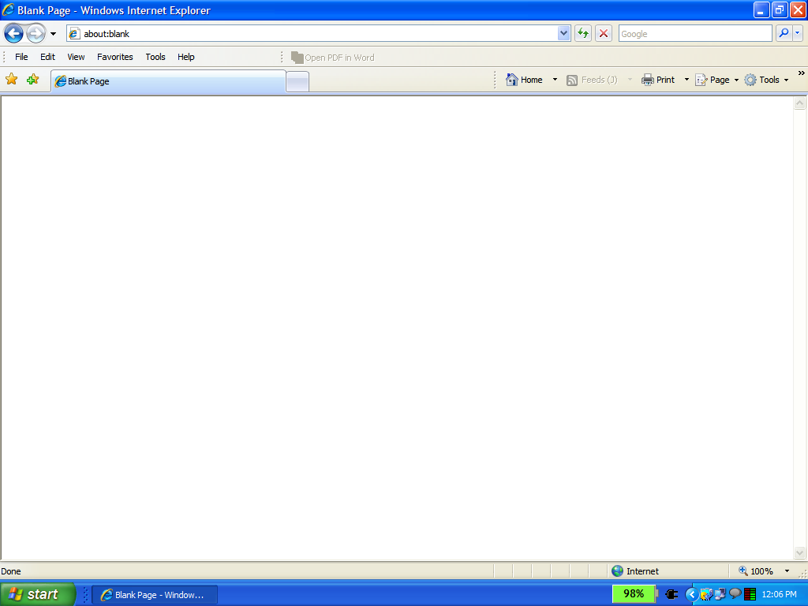
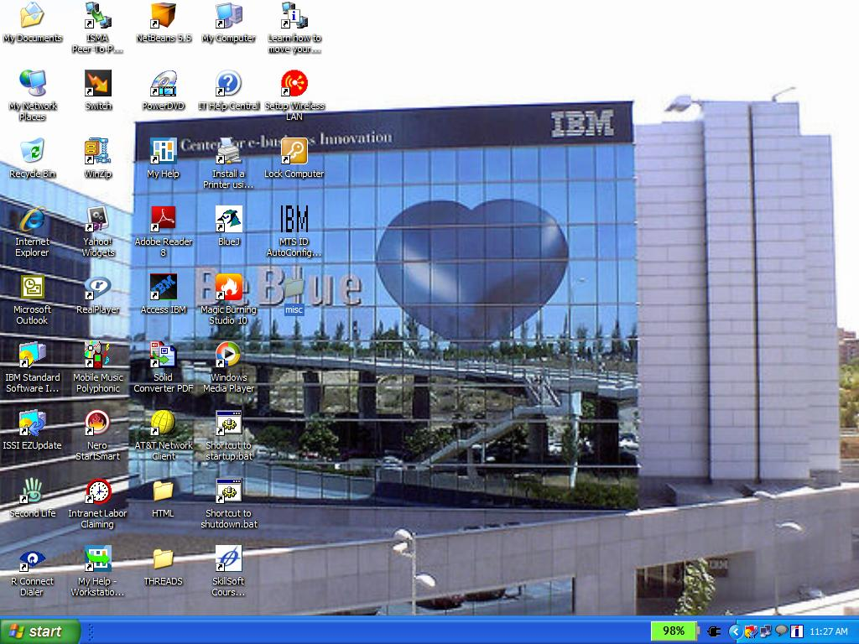
Browser Window Opens

Slide 12
http://www.google.co.in
Type the url address & Press Enter Key

Slide 13
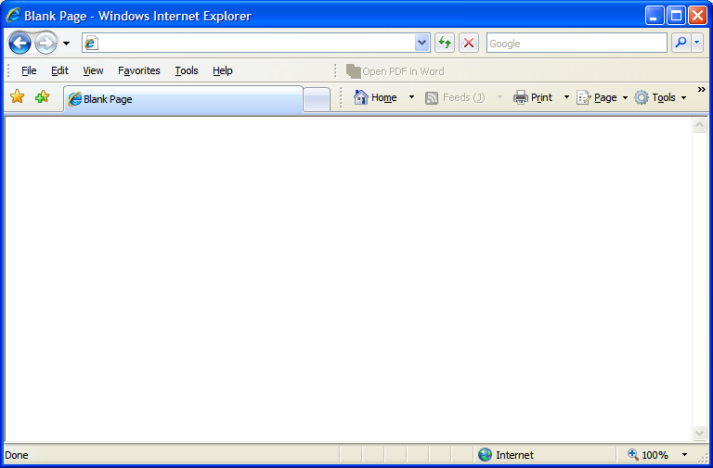
Internet
Web Server
Request
Request
http://www.google.co.in
HTML files
User makes a request
www.google.co.in

Slide 14
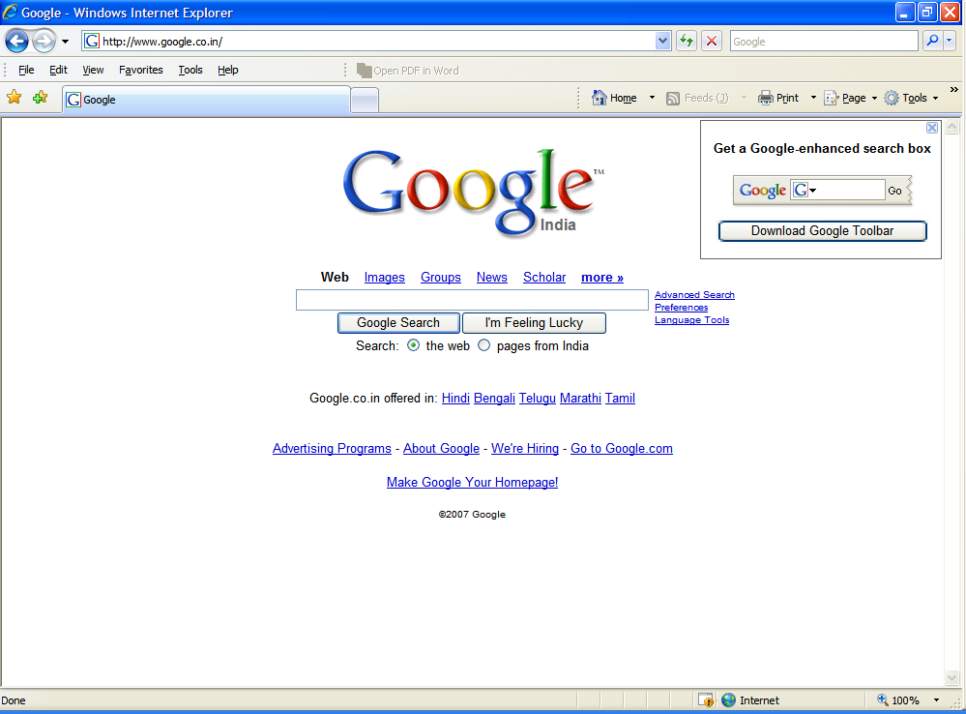
Internet
Web Server
Web Page
Web Page
HTML files
Google page is returned from the Web Server

Slide 16
Introducing HTML
A tag is a reference in an HTML document which describes the style and structure of the document.
What is a Tag
All tag start with < (less than symbol) and end with > (greater than symbol)
Tags which mark a beginning have no / (front slash).
Tags which mark an ending have a / immediately after <, as in </.

Slide 17
Introducing HTML
Example on Tag
Sample Tags
<HTML>, <BODY>, <TITLE>
</HTML>, </BODY>, </TITLE>
Starting tags / elements
Ending tags / elements

Slide 18
Introducing HTML
Explanation of the HTML code
<HTML>
<HEAD>
<TITLE> My Home Page </TITLE> - To give a title
</HEAD>
<!-- Written by Manas K Sahoo -->
<!-- Created: 30-May-2007 -->
<!-- Organization: IBM -->
<BODY>This is where the text goes.
</BODY>
</HTML>

Slide 19
Introducing HTML
Explanation of the HTML code
<HTML>
<HEAD>
<TITLE> My Home Page </TITLE>
</HEAD>
<!-- Written by Manas K Sahoo -->
<!-- Created: 30-May-2007 -->
<!-- Organization: IBM -->
<BODY>This is where the text goes.
</BODY>
</HTML>
Start of an HTML document.

Slide 20
Introducing HTML
Explanation of the HTML code
<HTML>
<HEAD>
<TITLE> My Home Page </TITLE>
</HEAD>
<!-- Written by Manas K Sahoo -->
<!-- Created: 30-May-2007 -->
<!-- Organization: IBM -->
<BODY>This is where the text goes.
</BODY>
</HTML>
Indicates to the browser that this is an HTML document.

Slide 21
Introducing HTML
Explanation of the HTML code
<HTML>
<HEAD>
<TITLE> My Home Page </TITLE>
</HEAD>
<!-- Written by Manas K Sahoo -->
<!-- Created: 30-May-2007 -->
<!-- Organization: IBM -->
<BODY>This is where the text goes.
</BODY>
</HTML>
HTML document is divided into two sections. 1. <HEAD> …. </HEAD>
Notes:
HTML documents are separated into two sections, the head and the body. The beginning of the head section is marked by the <HEAD> tag, and the end of the head section with the </HEAD> tag.

Slide 22
Introducing HTML
Explanation of the HTML code
<HTML>
<HEAD>
<TITLE> My Home Page </TITLE>
</HEAD>
<!-- Written by Manas K Sahoo -->
<!-- Created: 30-May-2007 -->
<!-- Organization: IBM -->
<BODY>This is where the text goes.
</BODY>
</HTML>
HTML document is divided into two sections. 2. <BODY> …. </BODY>
Notes:
The beginning of the body section is marked by the <BODY> tag, and the end of the body section with the </BODY> tag. The body tag has some attribute like,
1. Text – To change the text color for the whole document.
2. Background : To apply a background image for the document.
3. Link – To specify the link color.
4. Alink – To specify the color for the active link.
5. Vlink – To specify the color for the Visited link.

Slide 23
Introducing HTML
Explanation of the HTML code
<HTML>
<HEAD>
<TITLE> My Home Page </TITLE>
</HEAD>
<!-- Written by Manas K Sahoo -->
<!-- Created: 30-May-2007 -->
<!-- Organization: IBM -->
<BODY>This is where the text goes.
</BODY>
</HTML>
Shows the contents in the browser title bar. Generally placed inside Head tag.
Notes:
The title of the page must be placed within the head section. The beginning of the title is marked by the <TITLE> tag, and the end with the </TITLE> tag. Titles should be short, but descriptive, and limited to one line, so they can fit within the frame of the page.

Slide 24
Introducing HTML
Explanation of the HTML code
<HTML>
<HEAD>
<TITLE> My Home Page </TITLE>
</HEAD>
<!-- Written by Manas K Sahoo -->
<!-- Created: 30-May-2007 -->
<!-- Organization: IBM -->
<BODY>This is where the text goes.
</BODY>
</HTML>
Indicates comment tag. Can be placed anywhere in the document.
Notes:
The comment tag is different from the other tags for the following reasons. It can be placed anywhere in the HTML file; inside the head section, inside the body section, or in between the head and the body. It does not end with a /. It starts with an <!-- and ends with an -->.
It is always a good idea to put comments into your source code. In this simple example the comments state who is the author, the creation date of the document and name of the organization.

Slide 25
Introducing HTML
Explanation of the HTML code
<HTML>
<HEAD>
<TITLE> My Home Page </TITLE>
</HEAD>
<!-- Written by Manas K Sahoo -->
<!-- Created: 30-May-2007 -->
<!-- Organization: IBM -->
<BODY>This is where the text goes.
</BODY>
</HTML>
Signal the end of HTML document.

Slide 26
Introducing HTML
Kinds of Tags
1.
Range / Container tags
They are called so because they cover a range of text.
Example : <HTML>, <HEAD>, <BODY>, <TITLE>
2.
Standalone / Point tags
Those tags which do not need an ending.
Example: <HR>, <BR>
Notes:
<HR> tag is used for drawing a horizontal line. And <BR> tag is used to give a line break. Discussed later in more detail later.

Slide 27
Some of the Commonly Used Tags
<B> - To mark a text bold.
<I> - To make a text italic.
<U> - To underline a text.
<FONT> - Used for basic application of font properties like font size, font face, font color.
<marquee> - To scroll a text.
<img> - To insert an image in an HTML page.
<SOUND> - To insert an media file in an HTML page.
<OL>,<UL> - For creating a ordered and unordered list respectively.
<A> - Used for Hyperlinking (Internal as well as External linking)

Slide 28
Some of the Commonly Used Tags
<P> - Starts a new paragraph.
<HR> - Draw a horizontal rule.
<BR> - Forces a line break.
<!-- This is a comment entry --> - Used For Comment entry in HTML.
<H1> … <H6> - Different levels of heading tags.
<del> - It defines deleted text.
<ins> - It defines a inserted text.
<sub> - Defines subscripted text.
<sup> - Defines superscripted text.

Slide 29
HTML Table
Table allows to organize and present data in an orderly and concise manner.
Tabular structures were introduces with HTML 3.2.
A table can contains wide variety of information, such as headers, anchors, lists, paragraphs, forms, images, preformatted text and even nested tables.
HTML tables are composed of rows and columns.
Notes:
Prior to HTML 3.2, <PRE> tag were used to create table like structure.

Slide 30
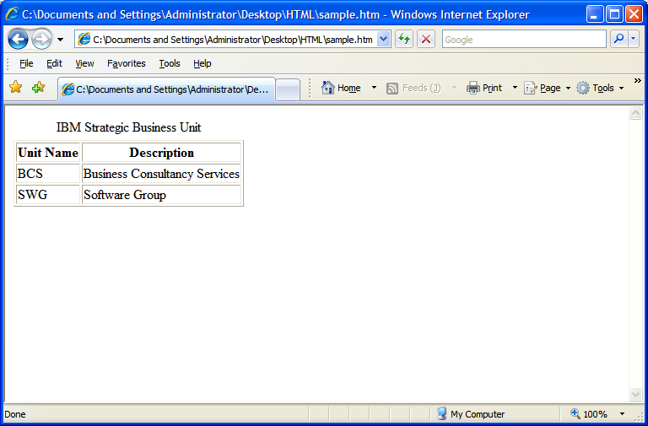
Requirement Analysis

Slide 31
Code Snippet To Fulfill the Requirement
<html>
<body>
<table border=“1”>
<caption>IBM Strategic Business Unit</caption>
<tr>
<th>Unit Name</th>
<th>Description</th>
</tr>
<tr>
<td>BCS</td>
<td>Business Consultancy Services</td>
</tr>
<tr>
<td>SWG</td>
<td>Software Group</td>
</tr>
</table>
</body>
</html>

Slide 32
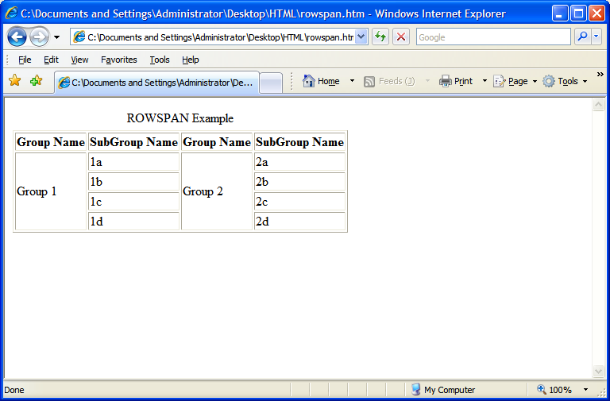
Requirement Analysis

Slide 33
Code Snippet To Fulfill the Requirement
<table border="1">
<caption>ROWSPAN Example</caption>
<tr><th>Group Name</th>
<th>SubGroup Name</th>
<th>Group Name</th>
<th>SubGroup Name</th>
</tr>
<TR>
<td ROWSPAN="4"> Group 1</td> <td>1a</td>
<td ROWSPAN="4"> Group 2</td><td>2a</td>
</tr>
<tr>
<td>1b</td>
<td>2b</td>
</tr>
<tr>
<td>1c</td>
<td>2c</td>
</tr>
<tr>
<td>1d</td>
<td>2d</td>
</tr>
</table>

Slide 34
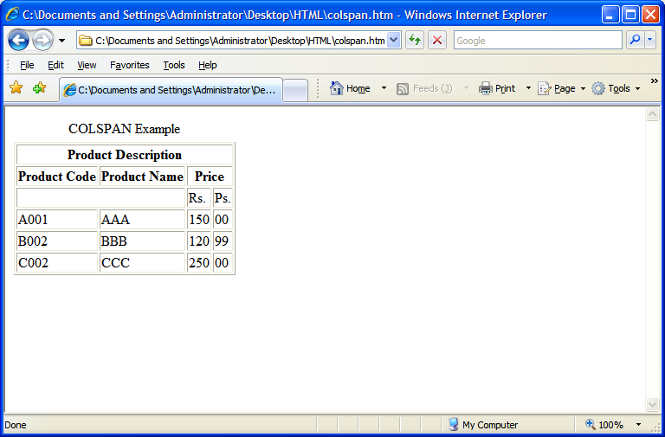
Requirement Analysis
Requirement

Slide 35
Code Snippet To Fulfill the Requirement
<tr>
<td>A001</td><td>AAA</td>
<td>150</td><td>00</td>
</tr>
<tr>
<td>B002</td><td>BBB</td>
<td>120</td><td>99</td>
</tr>
<tr>
<td>C002</td><td>CCC</td>
<td>250</td><td>00</td>
</tr>
</table>
<table border="1">
<caption>COLSPAN Example</caption>
<tr>
<th colspan="5"> Product Description</th>
</tr>
<tr>
<th> Product Code</th>
<th> Product Name</th>
<th colspan="2"> Price</th>
</tr>
<tr>
<td colspan="2">&nbsp;</td><td>Rs.</td><td>Ps.</td>
</tr>

Slide 36
Some More Attributes of Table tag
Cellspacing - The CELLSPACING attribute creates a space, or border, of the specified number of pixels, between each cell.
Cellpadding - The CELLPADDING attribute separates text of the cell from the cell border with a padding with the specified number of pixels.
Width - specify the width of the table

Slide 37
USING CELLSPACING ATTRIBUTE
<html>
<body>
<table cellspacing=“25" border="1">
<tr><th>Table Heading 1</th>
<th>Table Heading 2</th>
</tr>
<tr><td>Table Contents 1</td>
<td>Table Contents 2</td>
</tr>
</body>
</html>

Slide 38
USING CELLSPACING ATTRIBUTE
<html>
<body>
<table cellspacing=“25" border="1">
<tr><th>Table Heading 1</th>
<th>Table Heading 2</th>
</tr>
<tr><td>Table Contents 1</td>
<td>Table Contents 2</td>
</tr>
</body>
</html>

Slide 39
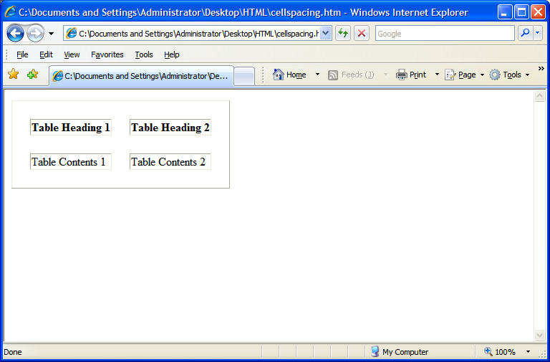
Vertical Cell spacing
Horizontal Cell spacing

Slide 40
USING CELLPADDING ATTRIBUTE
<html>
<body>
<table cellpadding=“25" border="1">
<tr><th>Table Heading 1</th>
<th>Table Heading 2</th>
</tr>
<tr><td>Table Contents 1</td>
<td>Table Contents 2</td>
</tr>
</body>
</html>

Slide 41
USING CELLPADDING ATTRIBUTE
<html>
<body>
<table cellpadding=“25" border="1">
<tr><th>Table Heading 1</th>
<th>Table Heading 2</th>
</tr>
<tr><td>Table Contents 1</td>
<td>Table Contents 2</td>
</tr>
</body>
</html>

Slide 42
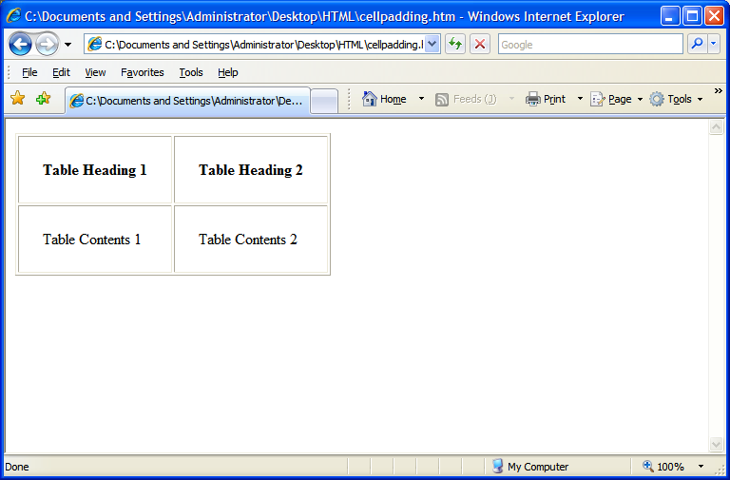
Horizontal Cell padding
Vertical Cell padding

Slide 43
USING WIDTH ATTRIBUTE
<html>
<body>
<table width=“80%" border="1">
<tr><th>Table Heading 1</th>
<th>Table Heading 2</th>
</tr>
<tr><td>Table Contents 1</td>
<td>Table Contents 2</td>
</tr>
</body>
</html>

Slide 44
USING WIDTH ATTRIBUTE
<html>
<body>
<table width=“80%" border="1">
<tr><th>Table Heading 1</th>
<th>Table Heading 2</th>
</tr>
<tr><td>Table Contents 1</td>
<td>Table Contents 2</td>
</tr>
</body>
</html>

Slide 45
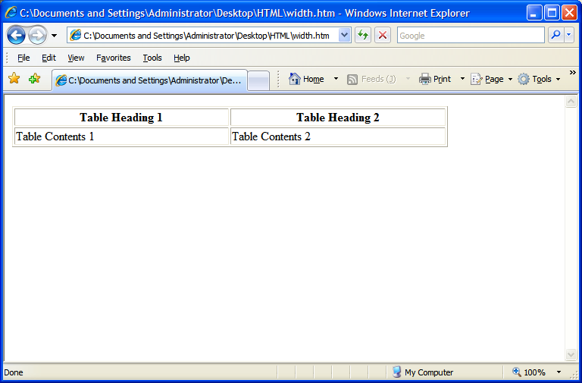
Cell Width

Slide 46
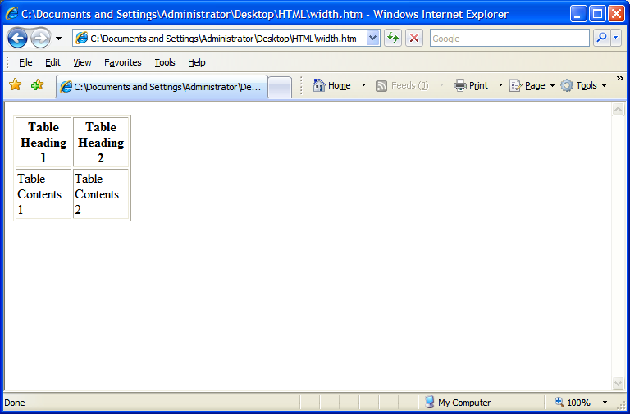
if Cell Width = 20%

Slide 47
Table Alignment Related Attribute
HTML tables can be aligned on the page, and cell content can be aligned within the cell.
  This attribute use to align HORIZONTALLY is
  ALIGN
LEFT
Attribute values are
CENTER
RIGHT
  This attribute use to align VERTICALLY is
  VALIGN
TOP
Attribute values are
MIDDLE
BOTTOM
The blinking attribute value is the default value for VALIGN.
Notes:
Default alignment of the information in the header cell is Center.
Default alignment of a data cell is Left.
VALIGN by default is Middle.

Slide 48
Table Alignment
ALIGN=“left”
ALIGN=“center”
ALIGN=“right”
VALIGN=“top”
Cell1 | Cell2 | Cell3
Cell4 | Cell5 | Cell6
Cell7 | Cell8 | Cell9
VALIGN=“middle”
VALIGN=“bottom”

Slide 49
Paragraphs
&
Line Breaks

Slide 50
Line Separators
Tags used for separating one line with other can be classifies as follows:-
  1.
  <P> tag
  2.
  <BR> tag
  3.
  <HR> tag

Slide 51
The <P> Tag
Normally all text in an HTML document is treated like one long paragraph. Indented or blank lines which normally indicate start of paragraphs in text are ignored.
To separate your text into paragraphs use the
The <P> tag forces an end of line and forces a blank line before the next paragraph.
<P>
tag.

Slide 52
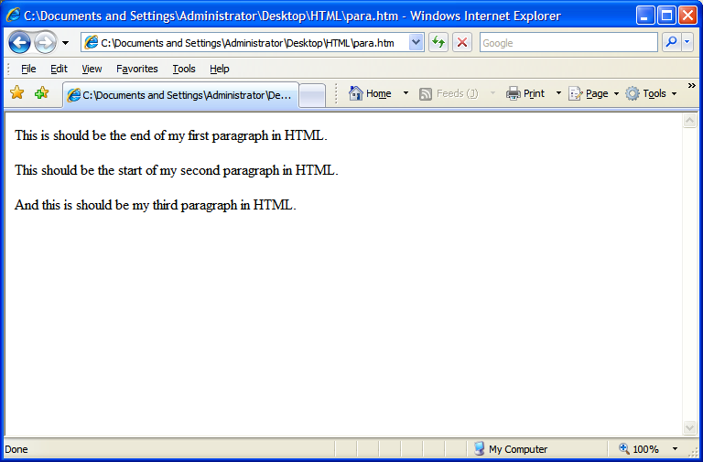
Requirement Analysis

Slide 53
Code Snippet To Fulfill the Requirement
<p>This is should be the end of my first
paragraph in HTML.</p>
<p>This should be the start of my second paragraph in
HTML.</p>
<p>And this is should be my third paragraph in
HTML.</p>

Slide 54
<p> tag forces an end of line and forces a blank line before the next paragraph.
<p>This is should be the end of my first
paragraph in HTML.</p>
<p>This should be the start of my second paragraph in
HTML.</p>
<p>And this is should be my third paragraph in
HTML.</p>
Ends the paragraph tag.

Slide 55
The <BR> Tag
Used to control the line breaks.
Use single spacing among the lines unlike <p> tag that uses double spacing among the paragraph.
Does not have a closing braces.

Slide 56
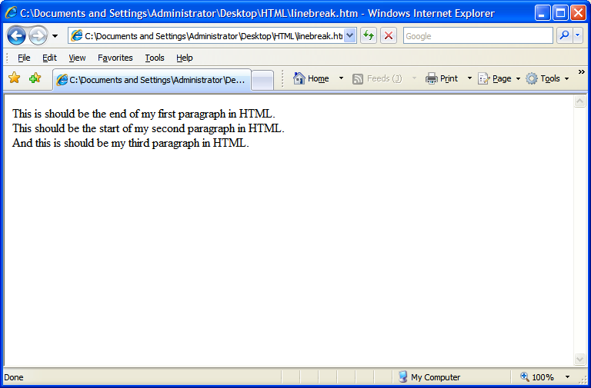
Requirement Analysis

Slide 57
Code Snippet to fulfill requirement: Forces line break with one line spacing between two lines.
This is should be the end of my first
paragraph in HTML.<br>
This should be the start of my second paragraph in
HTML.<br>
<p>And this is should be my third paragraph in
HTML.<br>

Slide 58
The <HR> tag
The <HR> tag draws a horizontal line across the page.
It acts a paragraph break.
There is no need to use the <BR> before or after the <HR> tag.

Slide 59
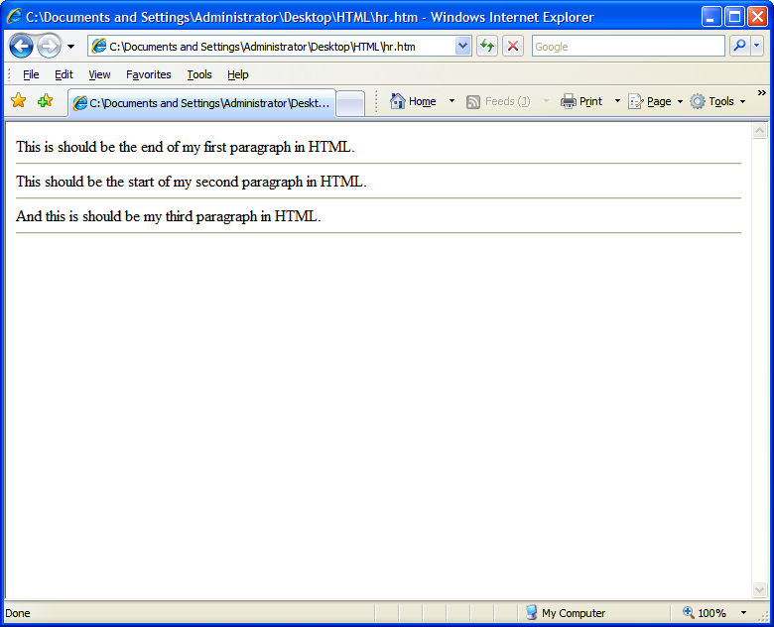
Requirement Analysis

Slide 60
Code Snippet fulfill the requirement: Draws a horizontal line across the page.
This is should be the end of my first
paragraph in HTML.<hr>
This should be the start of my second paragraph in
HTML.<hr>
And this is should be my third paragraph in
HTML.<hr>

Slide 61
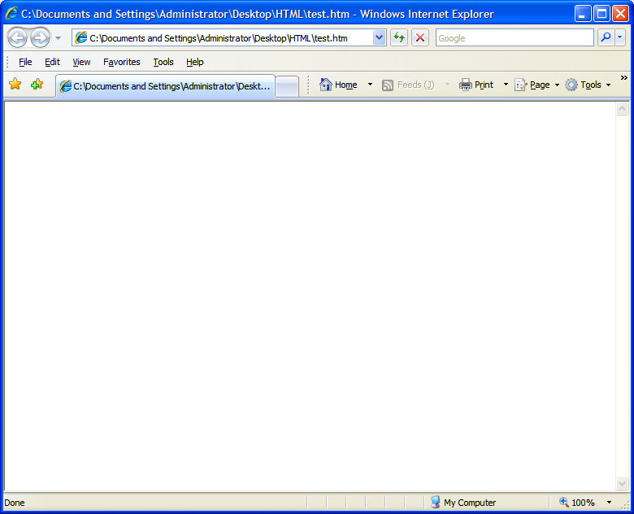
<HR> tag Attributes
  1.
  Color Attribute
How To Use
<hr color=“red”>
<hr color=“blue”>
<hr color=“pink”>

Slide 62
<HR> tag Attributes
  2.
  Width Attribute
How To Use
<hr width=“50%”>
<hr color=“blue” width=“100%”>
<hr color=“500”>
Default alignment of HR is center.
Notes:
Width value without percentage symbol is treated as a pixel value. So, 500 will be treated as 500 pixel.
By default, the horizontal rule starts from center.

Slide 63
<HR> tag Attributes
  3.
  Align Attribute
How To Use
<hr align=“left” width=“50%”>
<hr align=“right” width=“50%”>
<hr align=“center” width=“50%”>

Slide 64
<HR> tag Attributes
  4.
  Size Attribute
How To Use
<hr size=“5”>
<hr size=“3” color=“red”>
<hr align=“center” width=“50%” size=“2”>

Slide 65
The Headings Tags
<Hn>
To add headings in the HTML document use tag where, n represent number from 1 to 6.
Some text here
<H1>
</H1>
<H2>
Some text here
</H2>
<H3>
Some text here
</H3>
<H4>
Some text here
</H4>
<H5>
Some text here
</H5>
<H6>
Some text here
</H6>
Notes:
All the different levels of Headings tag has align as an attribute with “LEFT”, “RIGHT”, “CENTER” as values.

Slide 66
Listing In HTML
A common applications of HTML is to display the list of items.
The most popular types of lists that can be created using HTML are:
  Unordered List
  Ordered List
Notes:
List can also created using Definition List tags.
The definition list tag, or <DL>, can be used to define a definition. It is commonly used to describe items found in a glossary. The definition list is made up of a term, <DT>, and followed by one or more definition descriptions <DD> items.

Slide 67
Unordered List
When the list of contents that you want to display don’t have to follow any sequence then you can use Unordered list.
Each item in the unordered list is indented.
For Example, while creating list of Electronic products, where sequence of occurrence does not matter.
<UL>
tag is used to create a Unordered list.

Slide 68
Unordered List
When the list of contents that you want to display don’t have to follow any sequence then you can use Unordered list.
Each item in the unordered list is indented.
For Example, while creating list of Electronic products, where sequence of occurrence does not matter.
<LI>
tag identifies a item in the list.

Slide 69
Unordered List
<HTML>
<BODY>
<H3>List of Electronic Products</H3>
<UL>
<LI>T.V.</LI>
<LI>VCD</LI>
<LI>DVD</LI>
<LI>REFRIGERATOR</LI>
<LI>WASHING MACHINE</LI>
<LI>MICRO OVEN</LI>
</UL>
</BODY>
</HTML>
Check Out An Example

Slide 70
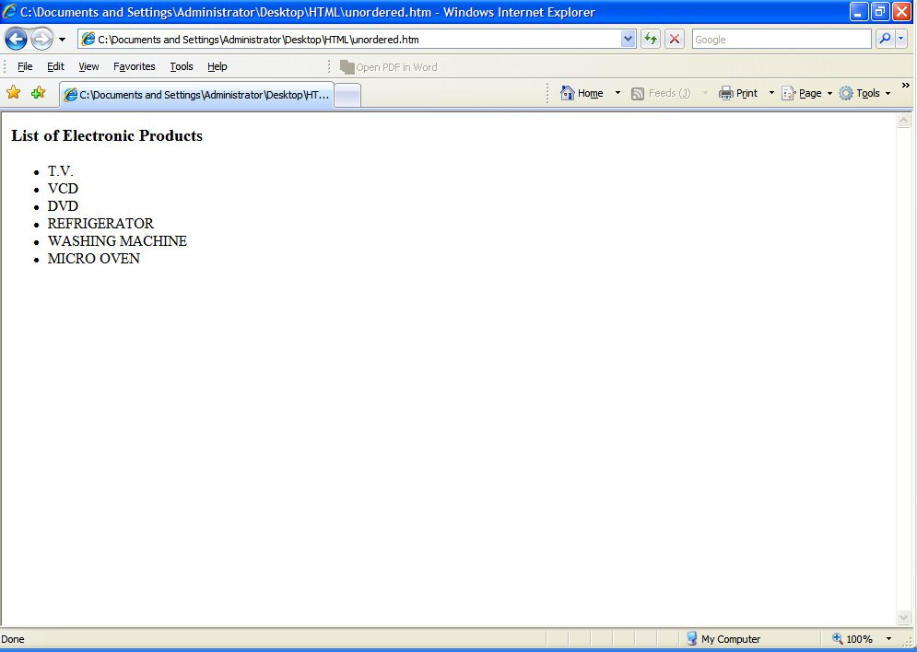
Check Out The
Output

Slide 71
Ordered List
When the list of contents that you want to display have to follow a sequence.
Each item in the ordered list is indented.
For Example, creating a list of students based on their merit.
<OL>
tag is used to create a Ordered list.

Slide 72
Ordered List
<HTML>
<BODY>
<H3>List of Fortune 500 Companies – Industry: Computers, Office Equipment Year 2006 Survey </H3>
<OL>
<LI>IBM</LI>
<LI>HP</LI>
<LI>Dell</LI>
<LI>NEC</LI>
<LI>Fujitsu</LI>
<LI>Canon</LI>
</OL>
</BODY>
</HTML>
Check Out An Example

Slide 73
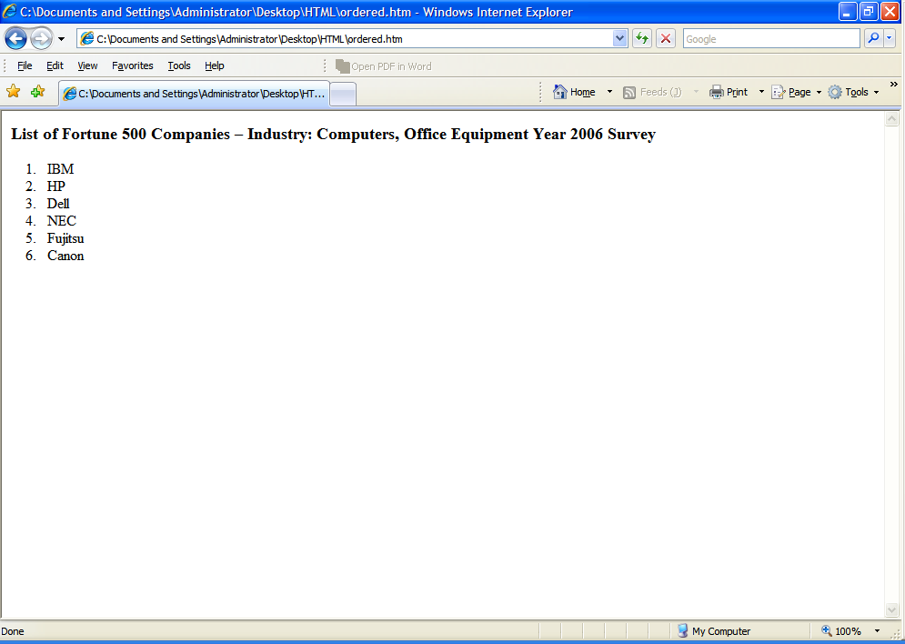
Check Out The
Output

Slide 74
Text Formatting and Alignment

Slide 75
Text Formatting
Character Styles
1.
<PRE> tag
2.
<BLOCKQUOTE> tag
3.
<ADDRESS> tag
4.
Logical Character Highlighting tags
5.
Physical Character Highlighting tags
Notes:
Character style tags are used to give text a different look when displayed by a browser.

Slide 76
Text Formatting (Contd.)
Character Styles
1.
<PRE> tag
It is used to include preformatted text into your HTML document.
Text will appeared exactly as typed including, tabs and returns.

Slide 77
Text Formatting (Contd.)
Character Styles
1.
<PRE> tag
Sample Code
<pre>
This is should be the end of my first paragraph in HTML.
This should be the start of my second
paragraph in HTML.</pre>
And this is should be my third paragraph in HTML.

Slide 78
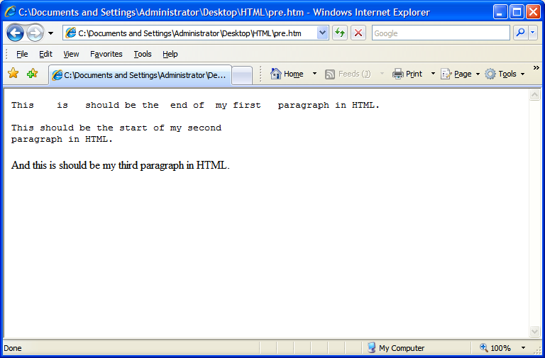
Text Formatting (Contd.)
Character Styles
1.
<PRE> tag
Sample Output

Slide 79
Text Formatting (Contd.)
Character Styles
2.
<BLOCKQUOTE> tag
Used to include indented text in a document.
Both the right and left margin are indented.
Notes:
<BQ></BQ> This element is an alias of the blockquote element.

Slide 80
Text Formatting (Contd.)
Character Styles
2.
<BLOCKQUOTE> tag
Sample Code
Most Popular Quote of Shakespeare :
<BLOCKQUOTE>
To Be, Or Not To Be: That Is The Question
</BLOCKQUOTE>

Slide 81
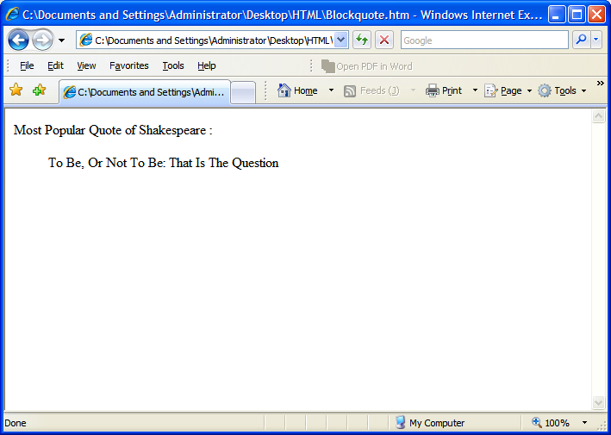
Text Formatting (Contd.)
Character Styles
2.
<BLOCKQUOTE> tag
Sample Output

Slide 82
Text Formatting (Contd.)
Character Styles
3.
<ADDRESS> tag
It defines text that gives an address or other contact information.
It is displayed in italic.
Generally, displayed in the bottom of the page.

Slide 83
Text Formatting (Contd.)
Character Styles
3.
<ADDRESS> tag
Sample Code
IBM stands for International Business Machines.
<hr color=“blue”>
The HeadQuarter is located at:
<ADDRESS>
IBM Armonk, <BR>New York, USA.
</ADDRESS>

Slide 84
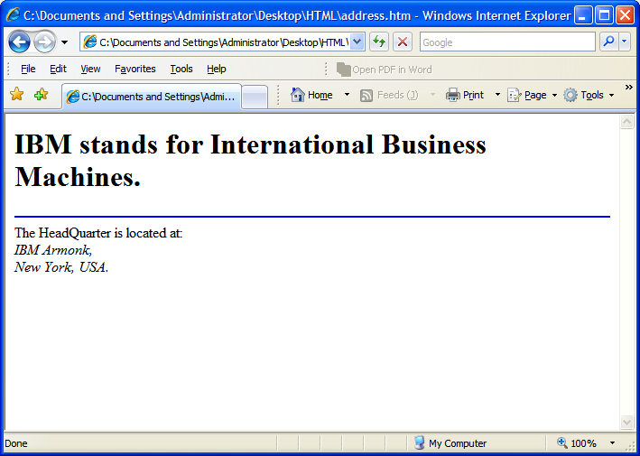
Text Formatting (Contd.)
Character Styles
3.
<ADDRESS> tag
Sample Output

Slide 85
Text Formatting (Contd.)
Character Styles
4.
Logical Character Highlighting tags
Logical Character Highlighters are also known as Idiomatic styles tags.
The purpose of logical tags is to convey the basic semantic meaning of a piece of text rather than the absolute appearance.
It is used to give your text a different look when displayed by browsers.
Browser handle the look and feel of the logical tag.
Notes:
Character styles are displayed differently by different browsers. For example, LYNX (a text-based browser), displays text marked with B, EM, I, and STRONG tags as underlined text, and text marked with SAMP and TT tags as normal text.
It is highly recommended to use logical styles instead of physical styles because the browser handles the display of logical styles and not all browsers support physical styles.

Slide 86
Text Formatting (Contd.)
Character Styles
4.
Logical Character Highlighting tags
Name | Tag | Example
Strong | <STRONG> | This is STRONG text
Emphasis | <EM> | This is EMphasized text
Code | <CODE> | This is CODEd text
Keyboard | <KBD> | This is “KeyBoarD” text
Variable | <VAR> | This is VARiable text
Notes:
Explanation of Each Logical Tags:-
1. Strong Emphasis: <STRONG> indicates strong emphasis, and typically appears in bold. This is preferred over <B> which is a physical tag.
2. Emphasis: <EM> is for emphasizing phrases, and is typically displayed in italics.
3. Code: <CODE> indicates an example of code, typically displayed in a uniform font. CODE is intended for short segments of computer code.
4. Keyboard: <KBD> indicates text typed by a user. It is typically displayed in a font and is commonly used in instructional manuals.
5. Variable: <VAR> indicates a variable, typically displayed in italic.
Some more Logical tags are:-
6. Sample: <SAMP> indicates a sequence of literal characters. It is typically displayed in a uniform font. For example: Use <samp>*.*</samp> to delete every file.
7. Citation: <CITE> is used to indicate the title of a book or other citation. It is typically displayed in italics.

Slide 87
Text Formatting (Contd.)
Character Styles
5.
Physical Character Highlighting tags
Physical Character Highlighters are also known as Typographical styles tags.
It is used to give your text a different look but exacting look.
Not all browsers support physical styles.

Slide 88
Text Formatting (Contd.)
Character Styles
5.
Physical Character Highlighting tags
Name | Tag | Example
Bold | <B> | This is Bold text
Italics | <I> | This is Italicized text
Underline | <U> | This is a underlined text
Teletype | <TT> | This is TeleType text
Superscript | <SUP> | X²Y³
Subscript | <SUB> | H₂SO₄
Notes:
Explanation of Each Physical Tags:-
Bold: <B> indicates bold text.
Italic: <I> indicates italics.
Underline: <U> indicates the text is underlined.
Note: Few browsers support this.
4. Teletype: <TT> indicates teletype or typewriter text, which is a uniform font.
5. Superscript: <SUP> Raise the text above the base line.
6. Subscript: <SUB> Drop the text below the base line.
Some more Physical tags are as follows:
7. Small: <SMALL> Display the enclosing text smaller than the usual font size.
8. Big: <BIG> Converse to <SMALL>, display the enclosing text bigger than the usual font size.
Note: <SUP>, <SUB>, <SMALL> and <BIG> are HTML 3.0 and might not be interpreted by older or text-only browsers.

Slide 89
Text Formatting (Contd.)
Font Tag
It is used to change the font color, font size, font face of text in an HTML document.
Notes:
With the introduction of style sheets for managing text appearance, the <FONT> Tag has been deprecated in HTML 4.0. meaning that it could disappear in a later version.
With the <basefont> tag you will be able to set the default font for your web page. We highly recommend specifying a basefont if you plan on using any font with HTML. Below is the correct way to set your basefont.

Slide 90
Text Formatting (Contd.)
Attributes of Font Tag
1.
Size
2.
Color
3.
Face
Notes:
Character style tags are used to give text a different look when displayed by a browser.

Slide 91
Text Formatting (Contd.)
Attributes of Font Tag
1.
Size
The primary <FONT> attribute is SIZE=x, where x is an
absolute value ranging from 1 to 7 or a relative vale (+/-).
Default font size is 3.
Largest font size can be set is 7.
Smallest is 1.

Slide 92
Text Formatting (Contd.)
Attributes of Font Tag
1.
Size
Html Code | Output
<FONT SIZE=4>HTML is Fun</FONT> | HTML is Fun
<FONT SIZE=+1>HTML is Fun</FONT> | HTML is Fun
<FONT SIZE=1>HTML is Fun</FONT> | HTML is Fun
<FONT SIZE=-2>HTML is Fun</FONT> | HTML is Fun
Notes:
Example shown both using absolute numbering and relative numbering. In the above example, both set of fetches the same result.

Slide 93
Text Formatting (Contd.)
Attributes of Font Tag
2.
Color
There are 3 different methods to set color.
i.
Generic Coloring System
ii.
RGB Coloring System
iii.
Hexadecimal Coloring System

Slide 94
Text Formatting (Contd.)
Attributes of Font Tag
2.
Color
i.
Generic Coloring System
Generics colors are preset HTML coded colors where the
value is simply the name of each color.

Slide 95
Text Formatting (Contd.)
Attributes of Font Tag
2.
Color
Sample Generic
Basic Colors
i.
Generic Coloring System
 | Black |  | Gray |  | Silver |  | White
 | Yellow |  | Lime |  | Aqua |  | Fuchsia
 | Red |  | Green |  | Blue |  | Purple
 | Maroon |  | Olive |  | Navy |  | Teal

Slide 96
Text Formatting (Contd.)
Attributes of Font Tag
2.
Color
ii.
RGB Coloring System
RGB stands for Red, Green, Blue. Each can have a value
from 0 (none of that color) to 255 (fully that color).
The format for RGB is – RGB (Red, Green, Blue)
Notes:
You should discourage the use of RGB coloring system for safe web page design because non-IE browsers do not support HTML RGB. But its used is desirable when using Cascading Stylesheet applications.

Slide 97
Text Formatting (Contd.)
Attributes of Font Tag
2.
Color
ii.
RGB Coloring System
Example
Output
<font color=RGB(255,0,0)>Confidence</font> | Confidence
<font color=RGB(255,255,0)>Confidence</font> | Confidence
<font color=RGB(0,0,255)>Confidence</font> | Confidence
<font color=RGB(0,0,0)>Confidence</font> | Confidence

Slide 98
Text Formatting (Contd.)
Attributes of Font Tag
2.
Color
iii.
Hexadecimal Coloring System
A hexadecimal is a 6 digit representation of a color.
XX
XX
XX
Red
Green
Blue
Notes:
Hexadecimal coloring system are far more reliable and widely compatible among web browsers and are the standard for colors on the internet.
A hexadecimal is a 6 digit representation of a color. The first two digits(RR) represent a red value, the next two are a green value(GG), and the last are the blue value(BB).
Hexadecimals are the best choice for compatible web development because of their consistency between browsers.
If you want to be absolutely sure your colors will not change, use paired hex values for color. Examples: "#0011EE", "#44HHFF", or "#117788". These are called True Colors .

Slide 99
Text Formatting (Contd.)
Attributes of Font Tag
2.
Color
iii.
Hexadecimal Coloring System
Example
Output
<font color=“#FF0000”>Confidence</font> | Confidence
<font color=“#FFFF00”>Confidence</font> | Confidence
<font color=“#0000FF”>Confidence</font> | Confidence
<font color=“#FFFFFF”>Confidence</font> | Confidence
Notes:
Hexadecimal Color Values:
Decimal 0 1 2 3 4 5 6 7 8 9 10 11 12 13 14 15
Hexadecimal 0 1 2 3 4 5 6 7 8 9 A B C D E F
The formula to convert an Hexadecimal number into Decimal Number:
For Example:- <font color=“#FF0000”>
The formula is really simple. Take the first value (F) or 15 multiply it by 16 and add it to the second value (F), i.e. 15.
For Hexadecimal color – FF0000
In notation,
(15*16)+15= 255.

Slide 100
Text Formatting (Contd.)
Color | Color Name | Hexadecimal Value |  | Color | Color Name | Hexadecimal Value
 | Black | #000000 |  |  | Green | #008000
 | Silver | #c0c0c0 |  |  | Lime | #00ff00
 | Gray | #808080 |  |  | Olive | #808000
 | White | #ffffff |  |  | Yellow | #ffff00
 | Maroon | #800000 |  |  | Navy | #000080
 | Red | #ff0000 |  |  | Blue | #0000ff
 | Purple | #800080 |  |  | Teal | #008080
 | Fushia | #ff00ff |  |  | Aqua | #00ffff
Notes:
Hexadecimal Color Values:
Decimal 0 1 2 3 4 5 6 7 8 9 10 11 12 13 14 15
Hexadecimal 0 1 2 3 4 5 6 7 8 9 A B C D E F
The formula to convert an Hexadecimal number into Decimal Number:
For Example:- <font color=“#FF0000”>
The formula is really simple. Take the first value (F) or 15 multiply it by 16 and add it to the second value (F), i.e. 15.
For Hexadecimal color – FF0000
In notation,
(15*16)+15= 255.

Slide 101
Text Formatting (Contd.)
Attributes of Font Tag
3.
Face
The font face attribute is used to specify the font name.
Example
<font face=“Serif”>Confidence</font> | Confidence
<font face=“Courier”>Confidence</font> | Confidence
<font color=“Monotype Corsiva”>Confidence</font> | Confidence
Notes:
Generic fonts are used while designing a web page. Web designer can't be sure of what fonts are installed on a computer. They can specify a list of fonts that they would like to see the text displayed with, but what actually appears on your screen depends on whether any of these fonts exist on your system.
There are 5 generic fonts:
Serif
sans-serif
monotypic
cursive
fantasy

Slide 102
Using Links
&
Images

Slide 103
Using Links
The Anchor Tag
  HTML uses the <a> (anchor) tag to create a link to another document.
  Attributes of <a>(anchor) tag
    href : is used to address the document to link to, and the words between the open and close of the anchor tag will be displayed as a hyperlink.
    Syntax:
    <a href=”url”>Text to be displayed</a>
Notes:
The <a> tag is used to create an anchor to link from, the href attribute is used to address the document to link to, and the words between the open and close of the anchor tag will be displayed as a hyperlink.

Slide 104
Using Links (Contd.)
  Attributes of <a>(anchor) tag
    target : The target attribute defines where the linked document will be opened.
    Syntax:
    <a href=“http://lw3.ibm.com” target=“where to place the document”>Text to be displayed</a>
    name :The name attribute is used to create a named anchor. When using named anchors we can create links that can jump directly into a specific section on a page.
    Syntax
    <a name=“label”>Text to be displayed</a>

Slide 105
Example of a Hyperlink
<html>
<head>
<title>Example of a Hyperlink</title>
<head>
<body>
<a href=“http://w3.IBM.com”> IBM</a>
<a href=“http://w3.IBM.com” target=“_blank”>IBM</a>
---- other information within body tag-------
</body>
</html>
The word IBM will be highlighted , and on clicking IBM the user will be taken to the w3 pages of IBM, the page will be opened on the same window
The word IBM will be highlighted , and on clicking IBM the user will be taken to the w3 pages of IBM, the page will be opened on a new window.
Notes:
HTML Email Tag
Set the href attribute of <a> to the e-mail address, rather than specifying a web URL.
HTML Code:
<a href= "mailto:landk@ibm.in.com" >Email Example</a>
E-Mail with subject & body of the mail defined.
<a href= "mailto: a@b.com?subject=Feedback Mail&body=This emails from IBM employees" >2nd Email Example</a>

Slide 106
Example of Naming a link and accessing it
<html>
<body>
<a name=“ loactions”>locations</a>
Kolkata, Bangalore, Hyd, Pune, Chandigarh, Gurgoan
----- other information
----------
<a href=“#locations”>IBM Location In India</a>
</body>
</html>
On Clicking on IBM Location in India you will be linked to the section which has been named as locations
Notes:
Named anchors are often used to create "table of contents" at the beginning of a large document. Each chapter within the document is given a named anchor, and links to each of these anchors are put at the top of the document.

Slide 107
Embedding Images
The image tag
  In Html images are defined by using the <img> tag
  The <img> tag is a open tag ( does not have a </img>)
  Attributes of <img> tag
    src : To display an image on a page, you need to use the src attribute . The value of the src is the url of the image to be displayed
    Syntax
    <img src=“url”>

Slide 108
Embedding images ( contd.)
  Attributes of <img> tag
    alt :The alt attribute is used to define an "alternate text" for an image. The value of the alt attribute is an author-defined text:
    Syntax
    <img src=“url” alt=“user defined text”>
    width & height : the size of the image can be controlled by using the width and height attributes
    Synatx
    <img src=“url” width=“size in pixels” height=“size in pixels”>
Notes:
The "alt" attribute tells the reader what he or she is missing on a page if the browser can't load images. The browser will then display the alternate text instead of the image. It is a good practice to include the "alt" attribute for each image on a page, to improve the display and usefulness of your document for people who have text-only browsers.

Slide 109
Embedding images(contd.)
  Attributes of <img> tag
    align : An image can be aligned with the surrounding text by using the align attribute
    Syntax
    <img src=“url” width=“value in pixels” height=“value in pixels” align=“positon, ie left,right,top bottom…” >
Images can be used as hyperlinks also.
<a href=“http://w3.ibm.com”> <img src=“logo.gif” width=“30 height=“40” ></a>

Slide 110
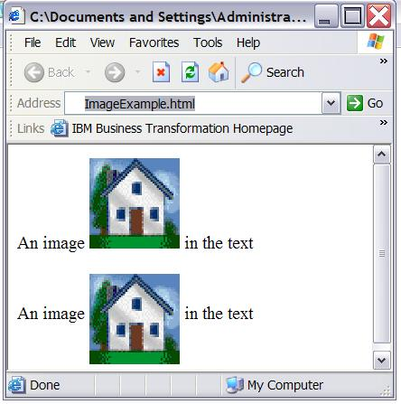
Example of an embedded image
<html>
<body>
<p>
An image
<img src=“home.gif"
align="bottom" width="48" height="48">
in the text
</p>
<p>
An image
<img src ="home.gif"
align="middle" width="48" height="48">
in the text
</p> </body> </html>
Notes:
Image Map
A graphic containing one or more invisible regions, called hotspots, which are associated hyperlinks. Typically, an image map gives site visitors visual cues about the information made available by clicking each part of a picture or graphic. For example, a geographical map could be made into an image map by assigning hotspots to each region of interest on the map.

Slide 111
Using Frames
In
HTML

Slide 112
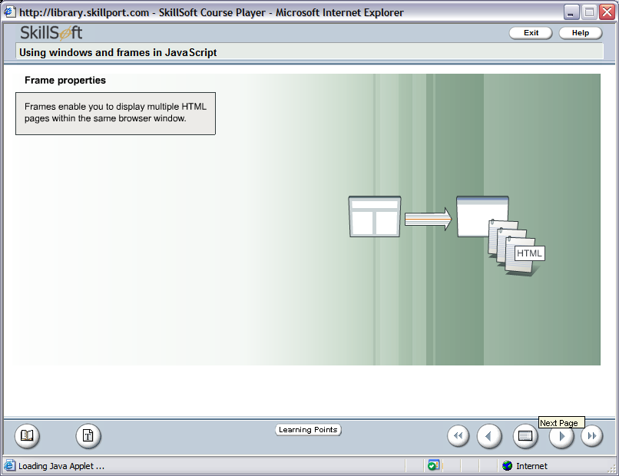
Frames
Frames enable you to display multiple HTML pages within the same browser window.
In
Document Object Model
Frames are instances of Window object

Slide 113
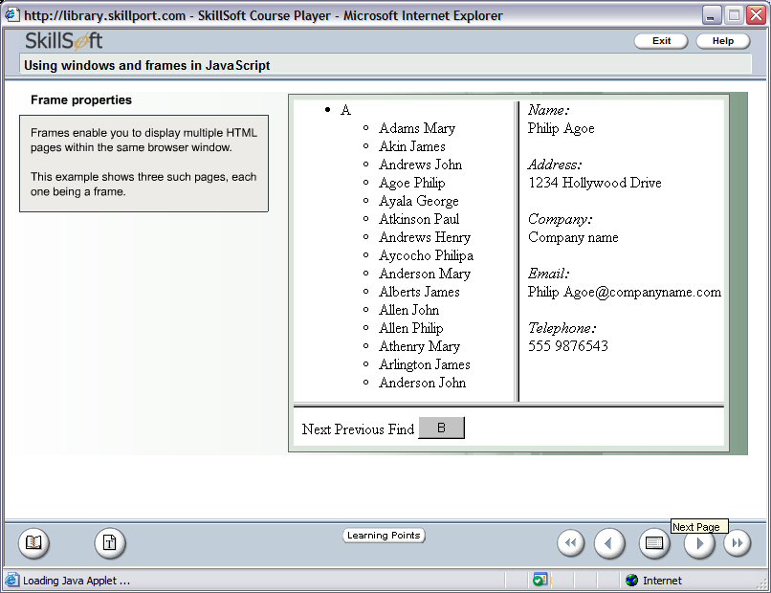
Frames (contd.)
The example show three such pages, each one being a frame.

Slide 114
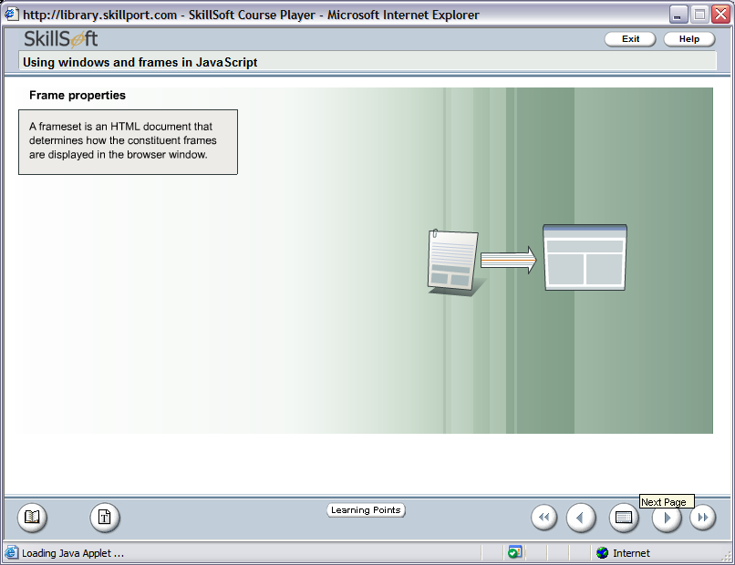
Frames (contd.)
A frameset is an HTML document that determines how the constituent frames are displayed in the browser window.

Slide 115
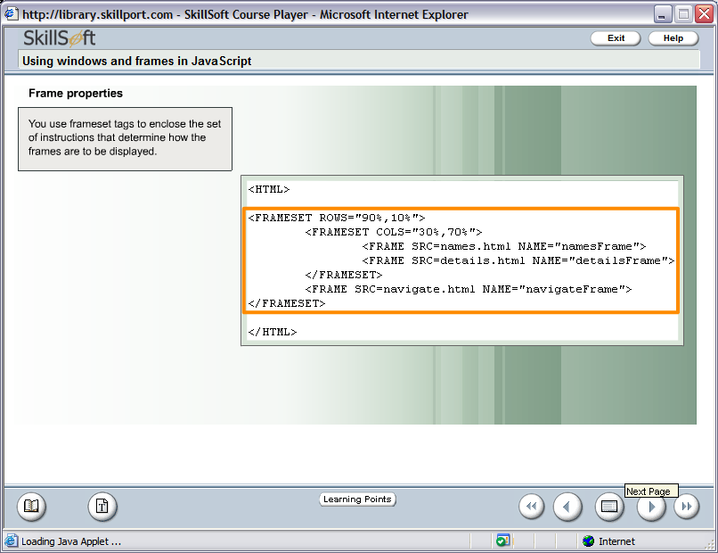
Frames (contd.)
Example on Frameset

Slide 116
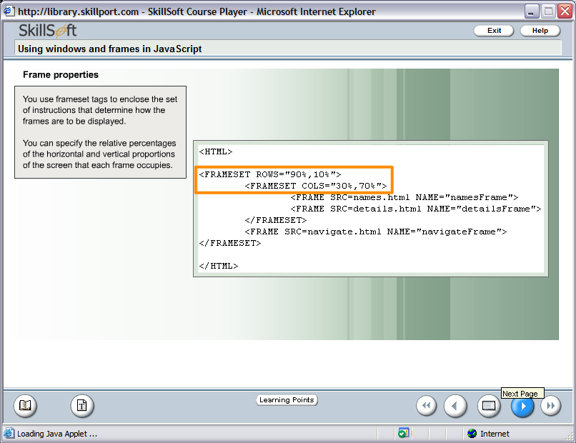
Frames (contd.)
You can specify the relative percentage of the horizontal and vertical proportions of the screen that each frame occupies.

Slide 117
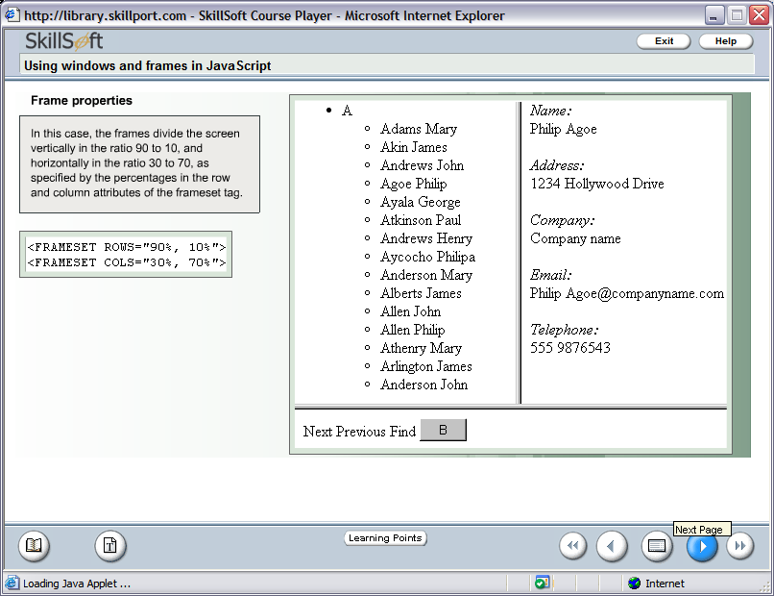
Frames (contd.)
In this case, the frames divide the screen vertically in the ratio 90 to 10 and horizontally in the ratio 30 to 70, as specified by the percentages in the row and column attributes of the frameset tag.
<FRAMESET ROWS=“90%,10%”>
<FRAMESET COLS=“30%,70%”>

Slide 118
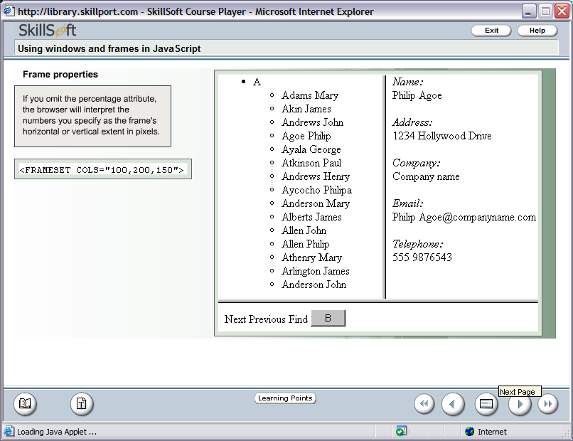
Frames (contd.)
If you omit the percentage attribute, the browser will interpret the numbers you specify as the frame’s horizontal or vertical extent in pixels.
<FRAMESET COLS=“100,200,150”>
It will fill the remaining window space if you give an asterisk.
<FRAMESET COLS=“100,*,150”>

Slide 119
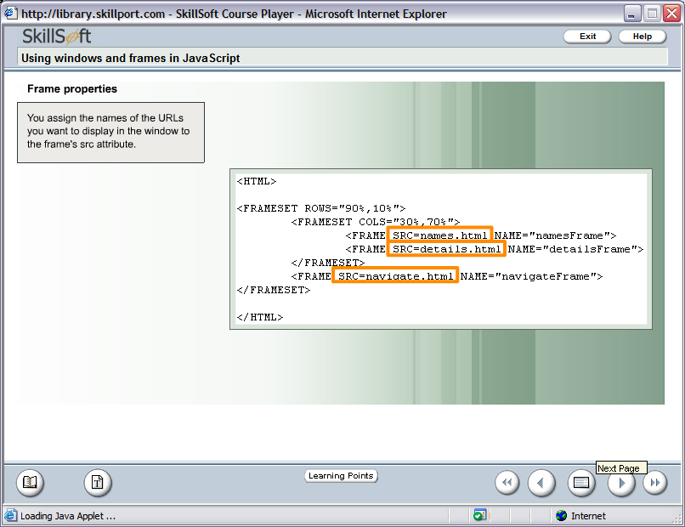
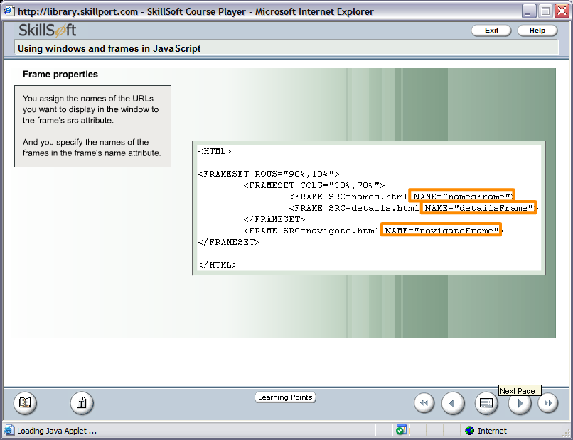
Frames (contd.)
You assign the name of the URLs you want to display in the window to frame’s src attribute. The frame’s name in the name attribute.

Slide 120
Frames (contd.)
Some other attributes of Frame tag are as follows:-
border
hscrolling
marginheight
marginwidth
noresize
scrolling
vscrolling

Slide 121
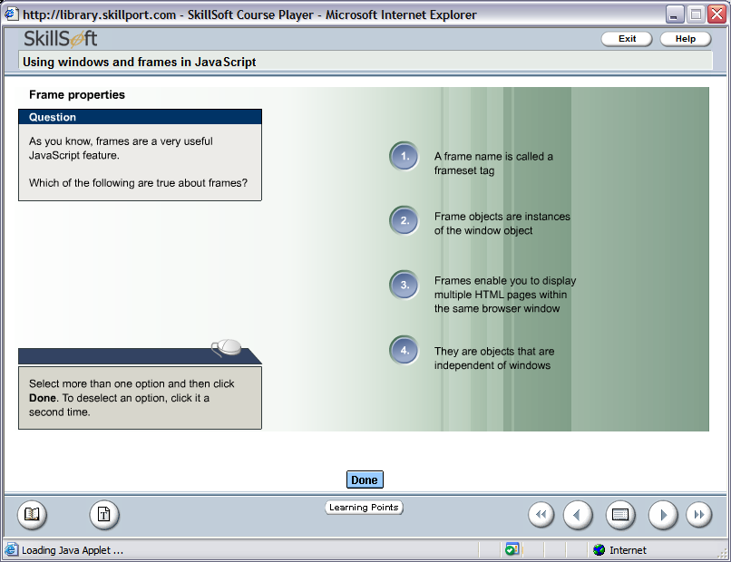

Test Your Understanding

Slide 122
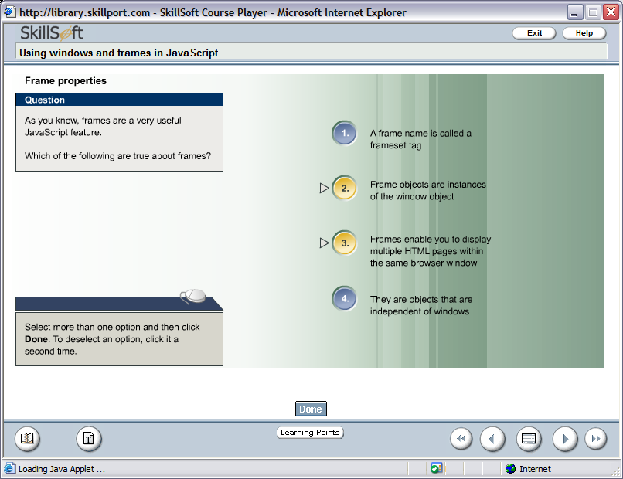
Test Your Understanding

Slide 123
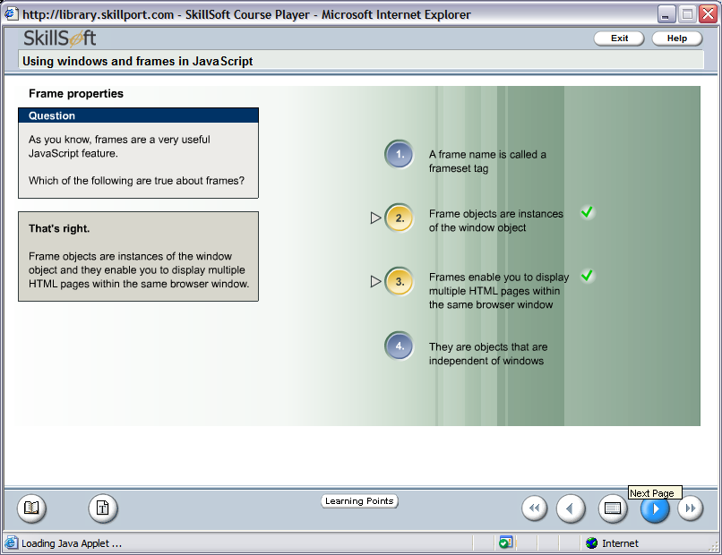
Test Your Understanding

Slide 124
Summary
HTML is used for publishing web page.
A tag is a reference in an HTML document which describes the style and structure of the document.
<TABLE> with <TR>,<TH>,<TD> tags are used to construct a tabular structure in HTML.
To create a List of items in HTML, tags used are <OL>and <UL>.
Tags that separate from one line to others are <P>, <BR>, <HR>.
It is used to include preformatted text into your HTML document.
<BLOCKQUOTE> tag is used to include indented text in a document.
The purpose of Logical Character Style tags is to convey the basic semantic meaning of a piece of text rather than the absolute appearance.
Physical Character Style tags is used to give your text a different look but exacting look.
<Font> tag is used to change the font size, color and face in a document.

Slide 125
Summary (Contd.)
Special characters are those that has a special meaning in HTML and those are not found on English keyboards.
HTML uses the <a> (anchor) tag to create a link to another document.
In Html images are defined by using the <img> tag
The <img> tag is a open tag ( does not have a </img>)
Web style sheets are a form of separation of presentation and content for web design .
CSS syntax is made up of three parts: Selector, property and value
Internal style sheets are used when a unique style is required for a document.
Internal style are defined in the <head> tag section by using the <style> tag

Slide 126
Summary (Contd.)
Internal style sheets are used when a unique style is required for a document.
Internal style are defined in the <head> tag section by using the <style> tag
With the class selector you can define different styles for the same type of HTML element
<Span> is a inline tag.
Span is used to format small chunks of data within another element. An HTML form is a section of a document containing normal content, markup, special elements called controls.
Some of the common controls are checkboxes, radio buttons, Textfields, etc.
Fieldset & Legend tags are used for grouping form elements and giving a suitable name to the group respectively.

Slide 127
Test Your Understanding
1. Select the correct option for making a hyperlink?
a. <a href="http://www.w3schools.com">W3Schools</a>
b. <a url="http://www.w3schools.com">W3Schools.com</a>
c. <a>http://www.w3schools.com</a>
d. <a name="http://www.w3schools.com">W3Schools.com</a>
2. Style Sheet can decide presentation of a web page
a. true
b. false

Slide 128
Test Your Understanding (Contd.)
3. The ___________ attribute of table tag separates text from the cell border
a. CELLPADDING
b. CELLSPACING
c. BORDERSPACING
d. TABLESPACING
4. What is the default font size in a web page.
1
2
3
5

Slide 129
Test Your Understanding (Contd.)
Match Group A with B
Group A
Group B
a. <TR>
i. Emphasizes the text enclosed within it.
b. <UL>
ii. Used to give a line break.
c. <STRONG>
iii. Creates a horizontal rule.
d. <BR>
iv. Creates a new row in a table
e. <HR>
v. Used to create a unordered list.

Slide 130
References
http://www.pierobon.org/iis/url.htm
http://w3schools.com/html
http://www.ology.org/tilt/cgh/ - Things to consider while developing web page using HTML.
http://www.tizag.com/htmlT
http://www.1stsitefree.com
http://www.quackit.com/html

